Slide 1
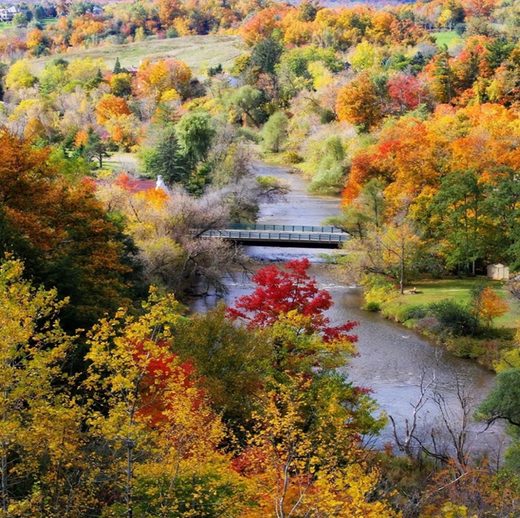
Development in Glen Williams
Update Meeting via ZOOM
October 26, 2022
Glen Williams Community Association Presentation
Glen Williams
Our Hamlet Our Home
Notes:
Good evening
Thanks very much for joining us tonight so we can share what’s going on with the most recent development issues
And the most recent development and most concerning issues are that all the developers in the Glen have gone to the Ontario Land Tribunal (formerly the Ontario Municipal Board) to get the rules changed for their own accommodation. This has taken the Town and the GWCA by surprise.
The format for this evening is Joan Griffin, the GWCA President, is going to give us the essential information about these appeals on this 10 slide powerpoint. We will leave everyone muted til the end. If you have questions or comments as she’s presenting, put them into the chat or make note of them so you can raise them at the end. We hope this meeting won’t last more than an hour. We are going to record it to make sure we hear everyone on this and get it onto our website so others can be made aware.
We likely can’t answer all your questions tonight – but we will follow-up with you and we do want to focus tonight on the two major appeals that have gone to the OLT. Right now, these are the most pressing development issues.
So Joan is going to start us off – I’ll play slide toggler and then we will both make sure the questions and comments are addressed later on.

Slide 2
Why we are here tonight
To bring you up to date on two legal appeals launched by developers to the Ontario Land Tribunal (formerly the Ontario Municipal Board)
1. 102 Confederation Street
Glen Williams Estates made the appeal
2. The Glen Williams Secondary Plan
Glen Williams Estates, Eden Oak and Charlston Homes made the appeal
Notes:
Why we are here tonight
This session is intended to bring you up to date on the two appeals launched by developers to the OLT formerly the OMB.
The 1st is the appeal filed by Glen Williams Estates the developer of 102 Confederation St. for 34 homes
This parcel of land contains considerable valley lands for anyone who is not familiar with it, it is bordered on two sides by designated natural heritage system lands as well to the north by designated greenbelt lands.
The GWCA was made aware of the appeal on September 26, 2022.
The first hearing for this appeal was held this past Monday, October 24, 2022.
The GWCA was made aware of the 2nd appeal against the Glen Williams Secondary Plan on September 27, 2022. The GWCA received this notice as we appeared as a delegation and submitted written comments at the June 14th, 2021, Public Meeting during the review.
There has been a Glen Williams Secondary Plan since 2007.
A Secondary Plan is a land use plan for a particular area of a municipality that is prepared as an amendment to an official plan.
Typically, a secondary plan will provide more detailed policies for the area it covers, such as special features, cultural heritage, public spaces, parks and urban design.
Secondary plans guide how the Official Plan regional policies are put in place for smaller municipalities.
A review was undertaken of the Plan beginning in April 2020.
The review was required as the 2007 version of the plan preceded a number of Provincial and Regional Plans which had revised policy directions for growth and development in Ontario.
And, as Town staff and the GWCA had identified a number of issues that required further review and consideration as well.
There are many stakeholders that contribute to a secondary plan including:
Glen Williams residents and landowners
Local businesses and business-owners
GWCA
Town of Halton Hills Climate Change Action Task-force
Heritage Halton Hills Committee
Mayor’s Youth Action Committee
Credit Valley Conservation;
The Region of Halton
Builders/Developers
And Other interested stakeholders.
In addition to the input of these stakeholders the plan is vetted to ensure alignment to
Provincial Statutes: Planning Act, Places to Grow Act, Greenbelt Act
Provincial Policies: Provincial Policy Statement 2020, A Place to Grow (Growth Plan) 2019, Greenbelt Plan 2019
Official Plans: Upper-Tier Municipality Region of Halton Official Plan, Office Consolidation 2018, Lower-Tier Municipality Town of Halton Hills Official Plan, 2017,
Land Use Control Instruments: Subdivision Control, Plan of Subdivision, Consents, Interim Control By-Law, Zoning By-Law, Holding By-Law, Increased Density/Height, Site Plan, Minister’s Zoning Order, Development Permit System
The final plan was approved by the Region and it is titled OPA 44 in October 2021

Slide 3
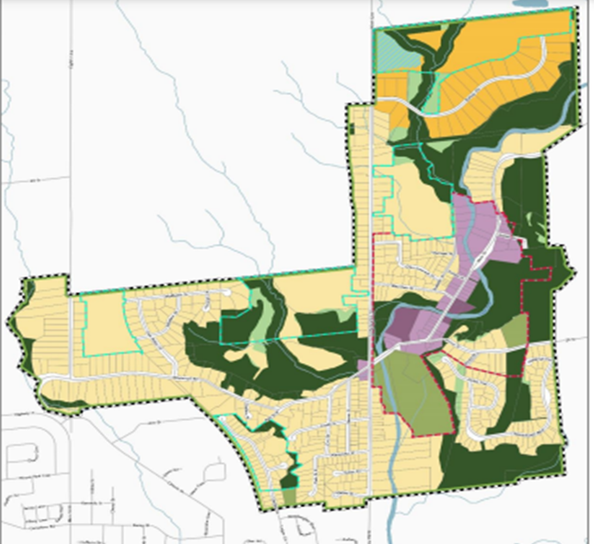
What’s available for development in the Glen
Four parcels of land owned by three developers:
Glen Williams Estates
Eden Oak
Charlston Homes
Schedule H4-1 from GWSP
Notes:
These appeals are critical events for the Glen.
The developers who have filed the appeals against the Glen Secondary Plan collectively own the 4 parcels of land designated for development in the Glen.
While all are at different stages, 3 of the 4 have open applications filed with the Town at present.
These are not just flat farmers fields, as we all know.
3 of the 4 parcels include designated natural heritage systems land as well as Natural Heritage Supportive Areas (dark green and lighter green on map).
And the Bishops Court parcel, as you will see in the upper left hand corner of the map in a light blue area is designated a special study area due to sensitive features there.
If the Tribunal sides with the developers in these hearings this will significantly weaken the secondary plan and our ability to protect and preserve the natural and cultural heritage features of the Glen.

Slide 4
Why did Glen Williams Estates appeal the 102 Confederation application?
Glen Williams Estates (102 Confederation) claimed that the Town was moving too slowly in approving their submission
The Town claimed they couldn’t approve their submission unless Glen Williams Estates addressed some outstanding issues
Notes:
102 Confederation St. Appeal
Both the Town and the GWCA were surprised by the filing of the appeal.
Over an 18-month period, the GWCA had met numerous times with the town to provide our issues list regarding the application.
We found that most of our issues were the same as the towns.
The town and the GWCA submitted our issues lists to the developer.
We had several exchanges.
Then responses from the developer stopped in March 2021. We did continue to meet with the Town to try and get information as late as May 2022.
The next thing we knew we received notice of appeal in September, 2022.
The developer claims the town was moving too slowly in approving the application, and the town claims they could not approve the application as submitted.
Responses to the issues put forward were not satisfactory to the Town, the Region or the CVC.

Slide 5
Why did developers appeal the Secondary Plan?
Five legal reasons given, but their reasons boil down to the following:
Not good land use planning
Not in the public interest
Hamlet buffers not based on science
Our Secondary Plan does not align with the provincial interest
Notes:
Why did the developers appeal the Glen Williams Secondary Plan?
This appeal is critical for the Glen.
We must make sure the Secondary plan continues to:
protect and preserve the natural and cultural heritage features of the Hamlet,
guide changes that maintain and enhance the unique character and natural environment of the Hamlet
Of note, we didn’t get everything we wanted in this 2021 Version of the Secondary Plan for example, the requirement of a 5-10 m hamlet buffer was reduced from 20 m in the prior version.
It is challenging at this time to really determine what the developers will focus on in the upcoming case management conference, however we suspect their goal is to weaken the Secondary Plan even further to limit their commitment to preserving natural heritage in order to get more houses on these parcels of land.

Slide 6
The Appeal Process through the OLT
If any resident or organization doesn’t like a planning decision, they can appeal directly to the Ontario Land Tribunal
The OLT process will start with a Case Management Conference
At the Case Management Conference stage they will determine the process for resolution. They will determine:
If the issues of the appeal are available for all to know
If this appeal can be resolved by mediation or a full hearing
Who will be ‘party’ to the appeal, or who will be a ‘participant’
The time frame for the process
Notes:
A bit about the appeals process
If any resident or organization doesn’t like a planning decision, they can appeal directly to the Ontario Land Tribunal (OLT).
The process will start with a Case Management Conference (CMC).
At the CMC stage they will determine the process for resolution.
They will determine:
If the issues of the appeal are available for all to know and if so, they will review everyone’s issues.
Can the appeal be resolved by mediation or is a full hearing required.
Who will be ‘party’ to the appeal, who will be a ‘participant’.
And the time frame for the process.
Anyone can dial into a CMC regardless if they have participant/party status.
Party status
Participate fully in the proceedings
Present opening and closing submissions
Bring expert witnesses
Examine and cross examine witnesses
Be cross examined
Be subject to cost charges by the Tribunal
Participant status
Essentially means your voice is recognized through your written submission.
Your submission outlines your position on the appeals and issues with supporting arguments.
A participant can continue to make written submissions throughout the proceedings.

Slide 7
102 Confederation Street Appeal Update
The outcomes of the October 24th Case Conference Meeting were:
Glen Williams Estates will submit a third proposal to the Town to address the outstanding issues already identified by the Town and the GWCA
Once the new proposal is available, there will be discussions between the Town and the developer on how to best resolve the issues.
As a ‘participant’ to the appeal, the GWCA can continue to represent the ‘public interest’, offer support and written recommendations to the Town
On March 13, 2023, there will be another conference meeting to update everyone.
Next steps will be determined then, for example, a full tribunal hearing or mediation
Notes:
The outcomes of the October 24th Case Conference Meeting for 102 Confederation St. were:
Glen Williams Estates will submit a third proposal to the Town to address the outstanding issues already identified by the Town and the GWCA.
Once the new proposal is available, there will be discussions between the Town and the developer on how to best resolve the issues.
As a ‘participant’ to the appeal, the GWCA can continue to represent the ‘public interest’, offer support and written recommendations with the Town/developer. And we will continue to do so.
On March 13, 2023, there will be another conference meeting to update everyone.
Next steps will be determined then, for example, if issues have been resolved fully, if mediation can help or if a full tribunal hearing is required.

Slide 8
Secondary Plan Appeal Update
The Case Management Conference is scheduled for November 8th, 2022
Our application must be in by Friday October 28th.
Our application and our reasons for asking for party status will be available on our website.
Notes:
Secondary Plan Appeal update
Case Management Conference is scheduled for November 8th, 2022 at 10:00am.
GWCA’s submission seeking party status is due Friday October, 28, 2022.
Our submission and reasons for asking for party status will be available on the GWCA website.

Slide 9
Actions taken by GWCA to support the Secondary Plan
Met with Town about understanding the reasons for the appeal
Discussions on way forward to gain support for the Secondary Plan
political, community, expert
Received assurance from the Town that they will defend and support the Secondary Plan as the Town and the Region have already approved it
Notes:
What Actions have been taken by the GWCA so far to support the Secondary Plan since learning about the appeals
Board members have met with Town about understanding the reasons for the appeal.
There have been had discussions with the town on a way forward to gain support for the Secondary Plan.
Received assurance from the Town that they will defend and support the Secondary Plan as the Town and the Region have already approved it. We will continue to keep their toes to the fire on this.
And we have had discussions with various people who have worked on other appeals with us and with the Town on previous Secondary Plans.

Slide 10
Our Submission Outline to the Secondary Plan Appeal
Our history with previous secondary plans and appeals
All plans and references to ‘hamlet buffers’ are in the public interest
The Secondary Plan was sufficiently vetted by experts and approved
There will be a focus on the Glen’s unique natural and sensitive features
Notes:
The GWCA Secondary Plan Submission Outline
A high-level overview of how we are approaching the writing of our submission is outlined below. We felt it important in this submission to:
Profile our history with previous and active Secondary Plans and developments.
Shine a light on the extent of public engagement in the creation of the plan. GWCA and other glen hamlet residents, business owners provided input throughout the review period. This plan was created in the public interest.
We will call out buffers with continued supporting arguments – buffers as defined in the plan are in the ‘public interest’, and must be conveyed to the town.
We will call out the sufficient vetting and approval processes that occurred against all levels of regulatory plans, policies, tools prior to approval.
We will focus on the extensive, sensitive and special features of the Glen and elements within the plan that have been put in place to protect them.
We want to impart on the Tribunal that as a residents’ association we can bring forward a perspective that is unique and may not be shared by the Town or the Developer.
We also want to showcase that:
We represent many people who live and work in the Glen.
Any development / land use issues impact not only property values but the quality of life for residents and the character of the community.
While Town representatives and Councillors may change with the passage of time, we represent people who will live with any new developments for decades to come.

Slide 11
Next Steps
For the GWCA:
Complete our Secondary Plan Submission to the Ontario Land Tribunal by October 28th at 4:30 PM
Participate in the November 8th OLT Case Management Conference
For the Community:
Support this work by:
Writing to Legal Counsels, Mayor, Councillors
Dial in to the Secondary Plan Case Management Conference hearing on November 8 (10:00 AM)
Tell us or send us any additional information you may have
Notes:
Next Steps
We will continue to keep you posted via:
Our fb page
Newsblasts/newsletters via email
Posting key documents to our website.
We will post a sample letter on our website that you can use to send to legal counsels, mayor and councillors.
There is power and strength in a collective voice. They need to hear from residents directly as well.
Feel free to share it with neighbours, friends etc.
If you feel we have missed anything please email us, send us information.

